Slide 1


BOOTH’S ALGORITHM
- The Multiplication Algorithm for Binary Numbers
Presented By -
V. Lakshmi Revanth Kumar
P. Vaseema khan
Batch – PGDVD 18

Slide 2
INTRODUCTION
What is Booth’s Algorithm?
Booth's algorithm is a multiplication algorithm that multiplies two binary integers efficiently, particularly for signed numbers in two’s compliment notation.
Purpose:
Optimizes multiplication by reducing the number of required addition and subtraction operations.
Particularly useful in hardware implementations, especially in processors.

Slide 3
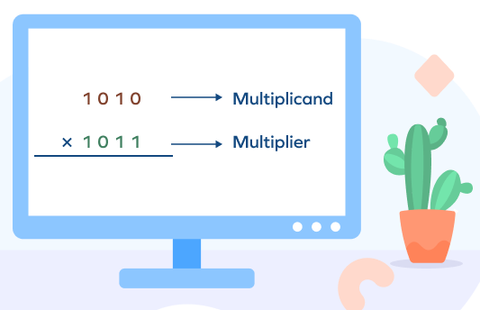
OBJECTIVE
"To efficiently multiply two signed binary numbers by reducing the number of addition and subtraction operations, optimizing performance for digital circuits and computer arithmetic."

Slide 4
Start
FLOWCHART
A=0 Q_1=0
M = Multiplicand
Q = Multiplier
N = No. of bits
Q0 Q_1
10
01
A = A + M
A = A - M
00
11
Arithmetic Right Shift (A,Q,Q_1)
No
N = 0 ?
Yes
End

Slide 5
FLOW CHART EXPLANATION
The multiplier and multiplicand are placed in the Q and M registers.
There is also a 1-bit register placed logically to the right of the least significant bit (Q0) of the Q register and designated Q-1.
The results of the multiplication will appear in the A (Accumulator) and Q registers. A and Q-1 are initialized to 0.
If the two bits are the same (11 or 00), then all of the bits of the A, Q, and Q-1 registers are shifted to the right 1 bit.
If the two bits differ, then the multiplicand is added to or subtracted from the a register, depending on whether the two bits are 01 or 10. Following the addition or subtraction, the right shift occurs.

Slide 6
=> -3 * 5 = -15 (4 – bit )
M = -3 = 1 1 0 1 Q = 0 1 0 1
-M = - (-3) = 3 = 0 0 1 1
EXAMPLE
A | Q (Q3 Q2 Q1 Q0) | Q_1 | Operation
0 0 0 0 | 0 1 0 1 | 0 | Initial
0 0 1 1 0 0 0 1 | 0 1 0 1 1 0 1 0 | 0 1 | A = A – M Right Shift
1 1 1 0 1 1 1 1 | 1 0 1 0 0 1 0 1 | 1 0 | A = A + M Right Shift
0 0 1 0 0 0 0 1 | 0 1 0 1 0 0 1 0 | 0 1 | A = A – M Right Shift
1 1 1 0 1 1 1 1 | 0 0 1 0 0 0 0 1 | 1 0 | A = A + M Right Shift
1 1 1 1 0 0 0 1
0 0 0 0 1 1 1 0
+ 1
0 0 0 0 1 1 1 1
If you want original number, again you can do 2’s compliment
The result is in 2’s Complimentary form

Slide 7
Advantages
Efficient handling of signed numbers
Faster Multiplication
Less Complexity
Flexible in scaling
Simplicity in implementation

Slide 8
APPLICATIONS
Digital signal processing
Microcontrollers and embedded systems
Computer graphics
Image processing
Telecommunications
Control systems

Slide 9
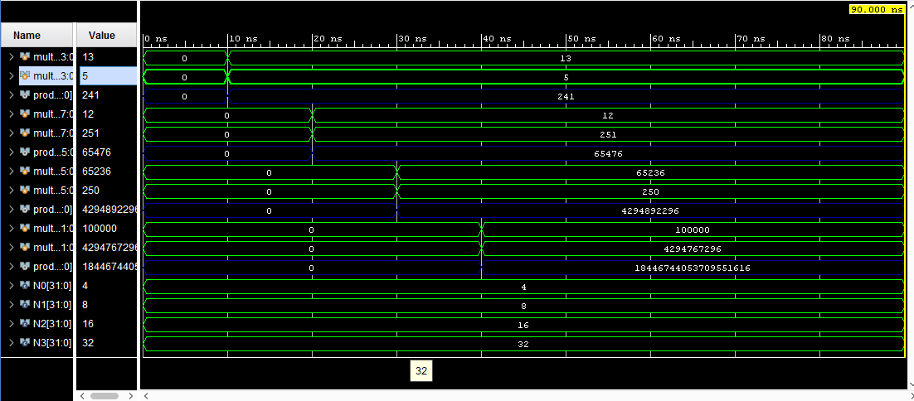
RESULTS
Fig: Output Wave Form for 4,8,16,32 - Bits

Slide 10
Conclusion
Booth's algorithm is a powerful and efficient method for binary multiplication, especially with signed numbers. By reducing the number of operations, it optimizes speed and performance, making it a valuable tool in digital arithmetic and processor design.

Slide 11

☺

